Slide 1
Cisco user level analysis
Dmitri Chtchourov,
Innovation Architect, CIS CTO Group

Slide 2
Agenda
A
Methodology
B
Overview
C
User analysis
D
Repo analysis
E
Language analysis
F
GitHub Event analysis
G
‘Read-me’ files analysis

Slide 3
Methodology
Objective
Analyze GitHub to identify what users with Cisco connection are working on
Get user-level information
Identify users with Cisco connection
Repository data
Data Exploration
Get GitHub users list
get user level attributes
Name
username
Email Id
Organisation
Bio
Location
Annotate user-level attribute (like Name, login id, email id ) with ‘Cisco’
Sanity check on the results
Pull detailed data for users with Cisco connection
# users following
# users followed
# public Repos
# public gists
Pull data for repositories owned by users with Cisco connection
language
description
# downloads
# watchers
# stars
# forked
Extract read-me file of all Repos
Explore to get insights of what users with Cisco connection are upt0?
Top contributors
most watched repos
most forked repos
Top languages used
What tools & technologies are used more by Cisco users
Baseline the stats with random sample repos from other users

Slide 4
Overview
GitHub has total user base of ~14 million users
Total # public repositories owned by these users is 17 million
Estimated time to pull data for all user and start analysis is 1 month
To start things we analyzed a random sample of 600,000 users
Note : We will refresh these numbers with the final data once data extraction of all users is complete.

Slide 5

User analysis
Basic Stats (Cisco list)
# Cisco users from Dmitri's List | 160
# Repos owned by Cisco Users | 1083
# Users following Cisco Users | 315
# Users followed by Cisco Users | 273
Basic Stats (Cisco TA Scrub list)
# Users analysed | 6,00,000
# Users with Cisco connection | 456
# Repos owned by Cisco Users | 1,557
# Users following Cisco Users | 797
# Users followed by Cisco Users | 923
Random Sample Data
Top 5 Users by # followers (Cisco List)
User ID | # Followers
fluffy | 55
danehans | 21
pcl | 17
BrianHicks | 17
ddutta | 15
Top 5 Users by # followers(Cisco TA Scrub list)
User ID | # Followers
V0lkan | 242
jonathanslenders | 158
AlexBaranosky | 63
ciscoheat | 40
tongueroo | 25
Jonathan Slender from Belgium is most active contributor from Cisco TA scrub list. He owns 6 out of the top 10 repos

Slide 6
Repo analysis
Analysed 1557 public Repos owned by Cisco Users.
Random Sample Data
User type : USERS (Cisco TA Scrub list)
User type : Organisation
Top 5 Repos by # Watchers
Repository Name | # Watchers
emit | 36
webrtc-w3c | 29
Markov-Generator | 14
django-plop | 10
cot | 8
Top 5 Repos by # Forks
Repository Name | # Forks
webrtc-w3c | 16
IETF-drafts | 8
openstack-skeleton | 7
ietf | 6
emit | 4
Top 5 Repos by # Watchers
Repository Name | # Watchers
openh264 | 1822
microservices-infrastructure | 1570
thor | 577
mesos-consul | 170
libsrtp | 158
Top 5 Repos by # Forks
Repository Name | # Forks
openh264 | 602
microservices-infrastructure | 156
nexus9000 | 98
libsrtp | 81
acitoolkit | 74

Slide 7
Language analysis
Python and Ruby were 2 popular scripting language in the Repos analysed. Puppet, Shell and Haxe saw high usage among Cisco Users but very low by general users.
Random Sample Data
Note : We will refresh all these numbers with the final data once data extraction of all users data is complete.

Slide 8
GitHub event analysis
Contribution was high in Feb & July this year. Top 6 Cisco users contributes 2/3rd all activities by cisco users
Note : We analyzed users from Cisco List provided. Only considered user who had at least 1 event since Jan-2015

Slide 9
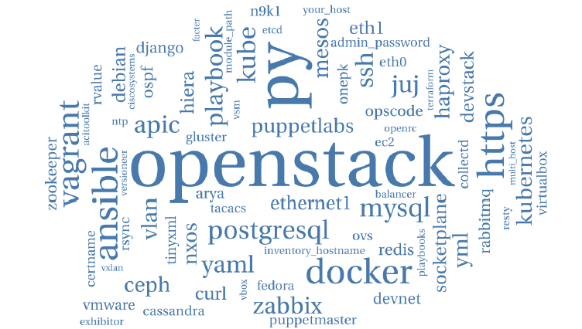
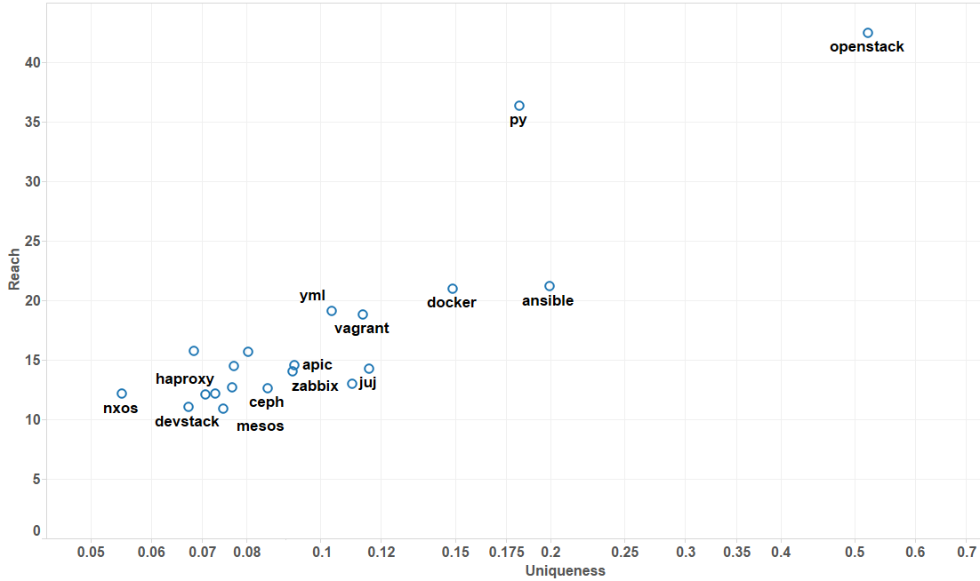
‘Read-me’ files analysis
‘Openstack’, ‘Ansible’ & ‘Python’ were the most widely used by Cisco users
Note : Reach is defined by the # mention of the text word in the read-me files
Uniqueness is related to TF-IDF; how much a text word is used in the read me files of Cisco users relative to General users.

